Slide 1
GRAPHING
EXPONENTIAL AND LOGARITHMIC
FUNCTIONS

Slide 2
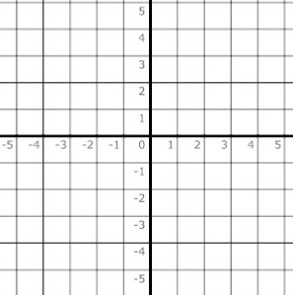
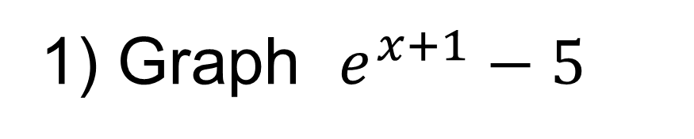
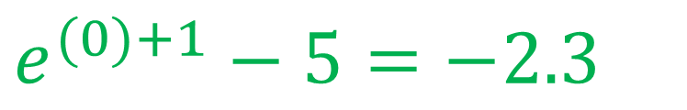
Left 1 and down 5
1) Graph $e^{x+1}−5$
$e^{(0)+1}−5=−2.3$
(0,-2.3)
Domain: (-∞,∞)
Range: (-5,∞)
(-1,-4)

Slide 3
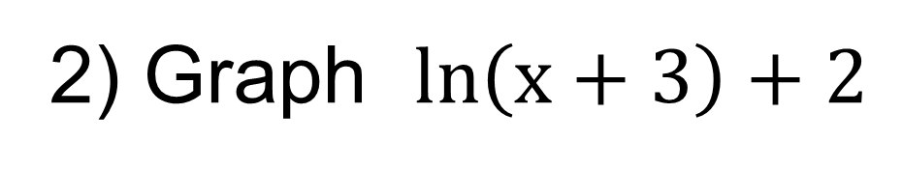
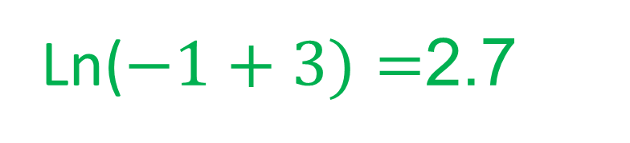
left 3 and up 2
2) Graph $ln\left(x+3\right)+2$
(-1,2.7)
(-2,2)
Ln($−1+3)=$2.7
Domain: (-3,∞)
Range: (-∞,∞)

Slide 4
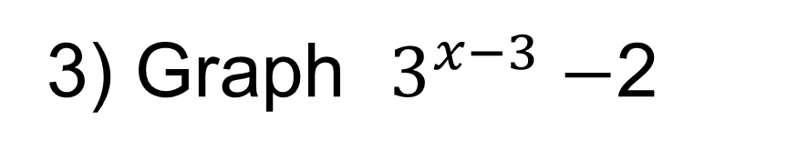
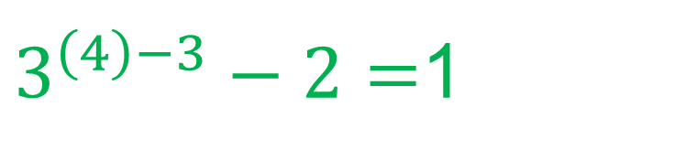
Right 3 and down 2
3) Graph $3^{x−3}−$2
(4,1)
$3^{\left(4\right)−3}−2=$1
(3,-1)
Domain: (-∞,∞)
Range: (-2,∞)

Slide 5
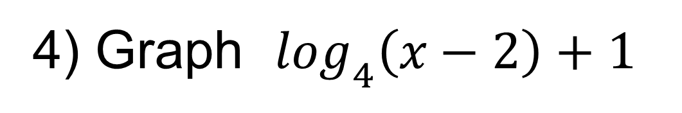
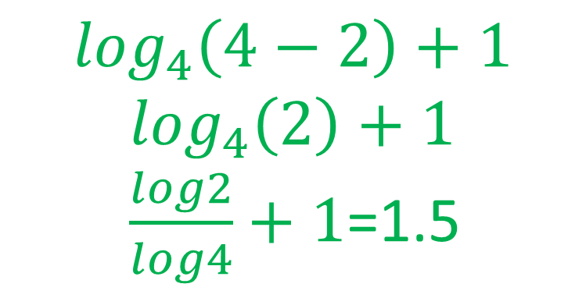
Right 2 and up 1
4) Graph $\log_{4}\left(x−2\right)+1$
$$\log_{4}\left(4−2\right)+1$$
$\log_{4}\left(2\right)+1$
$\frac{log2}{log4}+1$=1.5
(4,1.5)
(3,1)
Domain: (2,∞)
Range: (-∞,∞)

